Slide 1
Computer graphics
Semester 5 – Department of Informatics ITS 2017

Slide 2
Outline
Review Materi Minggu 3
Sistem Grafika
Programmer’s Interface
Arsitektur Sistem Grafika
Programmable Pipeline
Karakteristik Performa
Programming in OpenGL 1: Background
Sesi 1: Complete Programs
Sesi 2: Shaders

Slide 3
Review: Program Structure
Most OpenGL programs have a similar structure that consists of the following functions
main():
specifies the callback functions
opens one or more windows with the required properties
enters event loop (last executable statement)
init(): sets the state variables
Viewing
Attributes
initShader(): read, compile, and link shaders
callbacks
Display function
Input and window functions

Slide 4
Review: GLUT functions
glutInit initializes the GLUT system allows it to receive command line arguments (always include this line)
gluInitDisplayMode requests properties for the window (the rendering context)
RGBA color (default) or indexed colour (rare now)
Double buffering (usually) or Single buffering (redraw flickers)
Depth buffer (usually in 3D) stores pixel depths to find closest surfaces [usually with glEnable(GL_DEPTH_TEST);]
Properties are bitwise ORed together with | (vertical bar)
glutInitWindowSize in pixels
glutInitWindowPosition from top-left corner of display

Slide 5
Review: GLUT functions
glutCreateWindow create window with title “Title”
many functions need to be called prior to creating the window
similarly many other functions can only be called afterwards
glutDisplayFunc set display callback
glutKeyboardFunc set keyboard callback
glutReshapeFunc set window resize callback
glutTimerFunc set timer callback
glutIdleFunc set idle callback
glutMainLoop enter infinite event loop
never returns, but may exit

Slide 6
Review: Immediate Mode Graphics
Geometry specified by vertices
Locations in space( 2 or 3 dimensional)
Points, lines, circles, polygons, curves, surfaces
Immediate mode
Each time a vertex is specified in application, its location is sent to the GPU
Old style uses glVertex
Creates bottleneck between CPU and GPU
Removed from OpenGL 3.1

Slide 7
Review: Retained Mode Graphics
Put all vertex and attribute data in array
Send array to GPU to be rendered immediately
Almost OK but problem is we would have to send array over each time we need another render of it
Better to send array over and store on GPU for multiple renderings

Slide 8
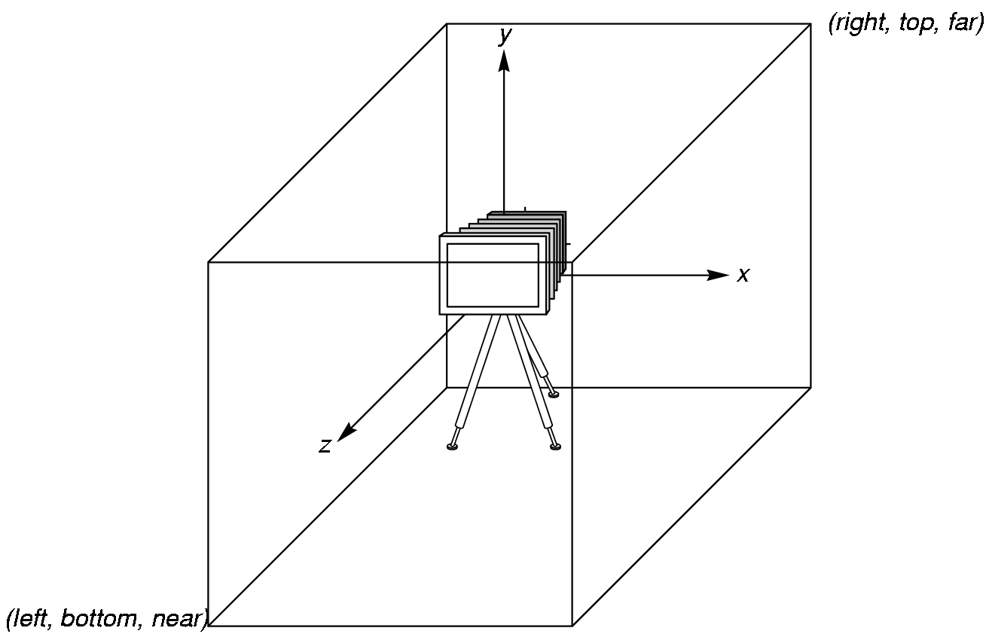
Review: OpenGL Camera
OpenGL places a camera at the origin in object space pointing in the negative z direction
The default viewing volume
is a box centered at the
origin with a side of
length 2

Slide 9
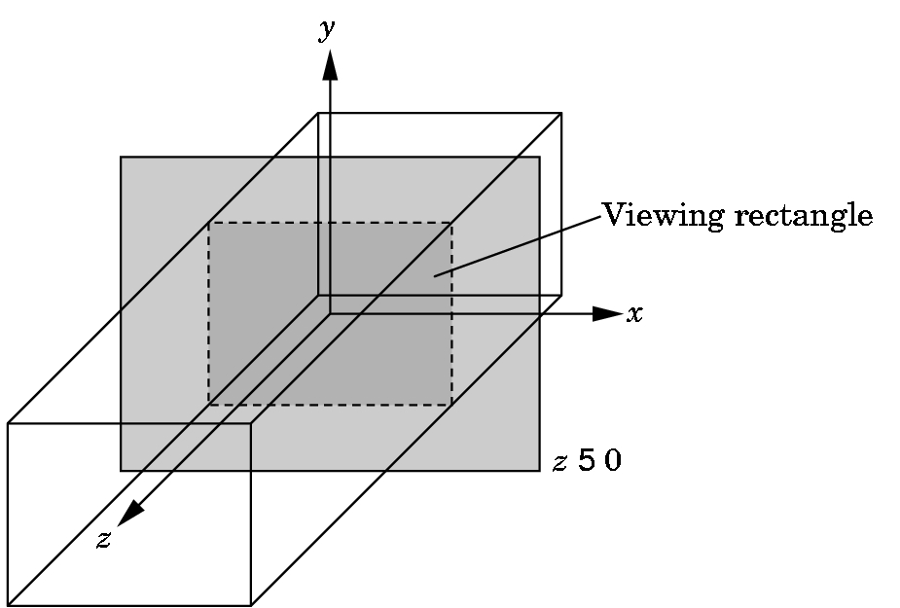
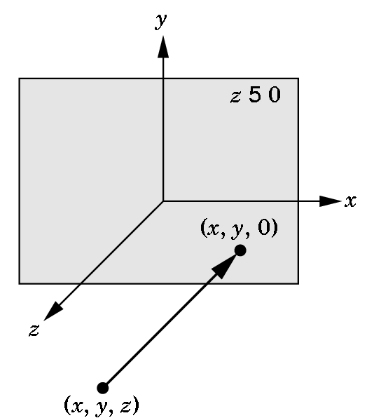
Review: Orthographic Viewing
In the default orthographic view, points are
projected forward along the z axis onto the
plane z=0
z=0
z=0

Slide 10
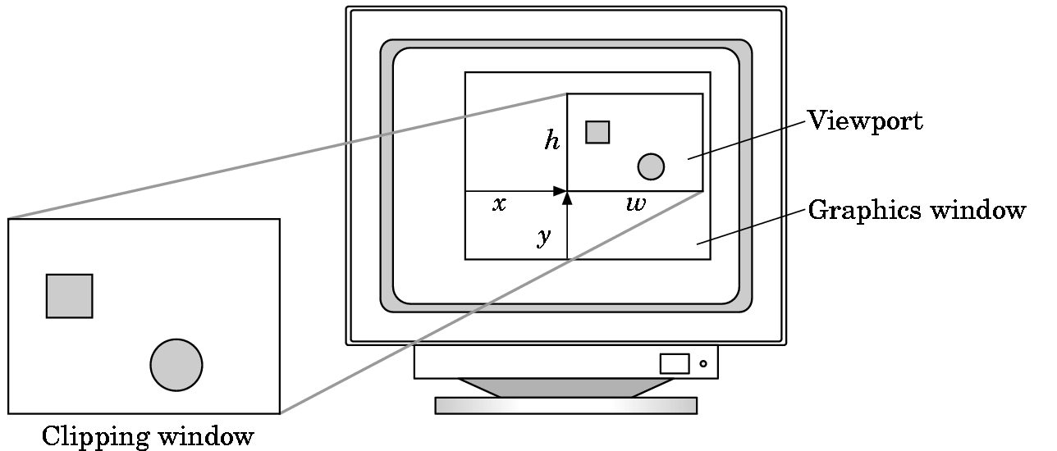
Review: Viewports
Do not have use the entire window for the image: glViewport(x,y,w,h)
Values in pixels (screen/window coordinates)

Slide 11
Review: Vertex Shader Applications
Geometric transformations
Change relative location, rotation, scale of objects/camera
3D perspective transformation – make far objects smaller
Moving vertices
Morphing
Wave motion & deformation due to physical forces
Particle effects – for fire, smoke, rain, waterfalls, …
Fractals
Lighting
Calculate shading color using light and surface properties
Can choose between less/more realistic models (unlike the fixed pipeline)
Cartoon shaders, other special effects

Slide 12
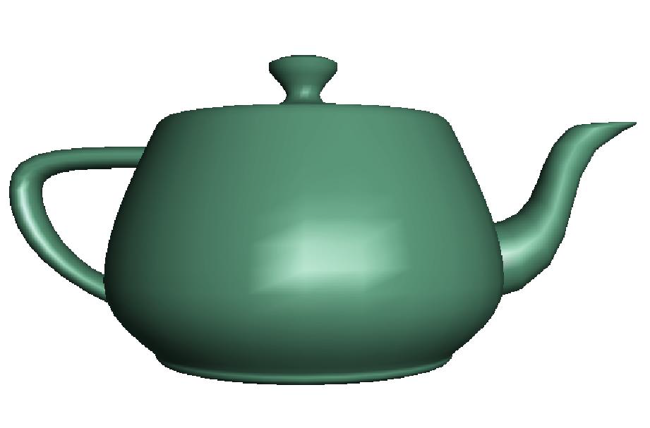
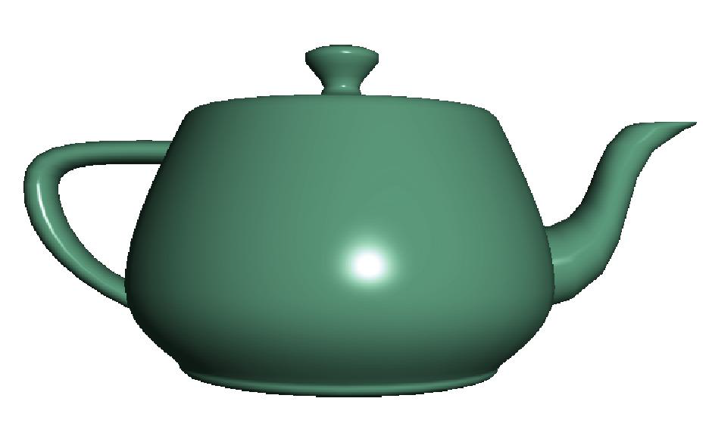
Review: Fragment Shader Applications
Per fragment lighting calculations
per vertex lighting per fragment lighting

Slide 13
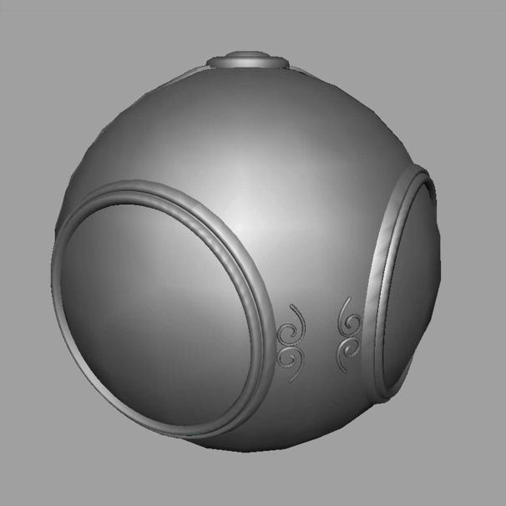

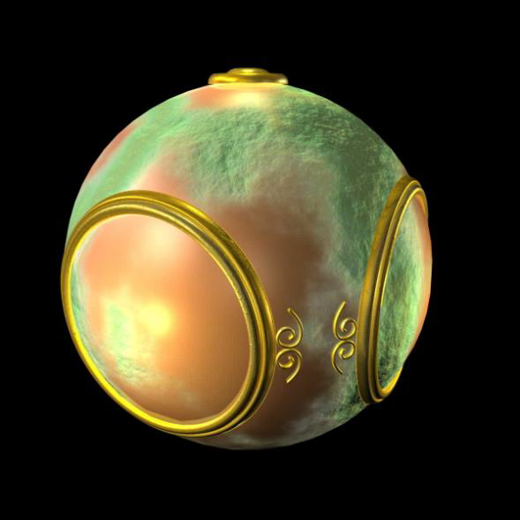
Review: Fragment Shader Applications
Texture mapping
smooth shading environment mapping bump mapping

Slide 14
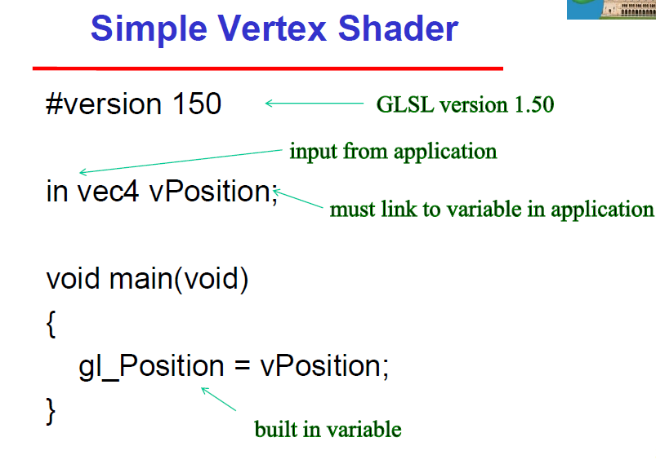
Simple Vertex Shader

Slide 15
Simple Fragment Program
#version 150
out vec4 fragcolor;
void main(void) {
fragcolor = vec4(1.0, 0.0, 0.0, 1.0);
}

Slide 16
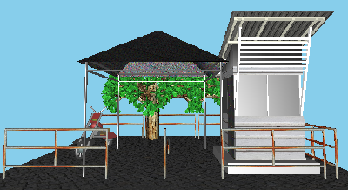
Session 1: Polygons and Attributes

Slide 17
Objectives
Expanding primitive set
Adding color
Vertex attributes
Uniform variables

Slide 18
Objek Geometri Primitif
Salah satu isi dari API adalah fungsi untuk menspesifikasikan objek geometri primitif, seperti titik, garis, poligon, dsb.
Di komunitas grafika, objek apa saja yang harus disediakan sebuah API menjadi perdebatan:
Sisi minimalis: API hanya mendukung objek-objek primitif yang bisa dihasilkan semua hardware, seperti garis, poligon, dan teks
Sisi yang lain menginginkan objek seperti lingkaran, kurva, surface, dan benda padat juga disupport. Kelemahannya kurang portable.
Dengan berkembangnya hardware dan meningkatnya kecepatan rendering poligon per detik, sisi mana yang akhirnya dikembangkan?

Slide 19
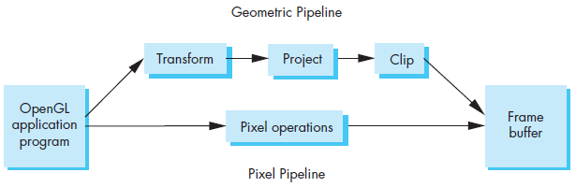
Jenis Objek Primitif
Ada dua jenis objek primitif:
Primitif geometri
Primitif raster/gambar
Primitif geometri (titik, segmen garis, poligon, kurva, surface) diproses melalui geometric pipeline
Primitif raster (arrays of pixels) diproses melalui pipeline yang berbeda: pixel pipeline. More on this: texture mapping

Slide 20
OpenGL Primitives
GL_POINTS
GL_LINES
GL_LINE_STRIP
GL_LINE_LOOP
GL_TRIANGLES
GL_TRIANGLE_STRIP
GL_TRIANGLE_FAN

Slide 21
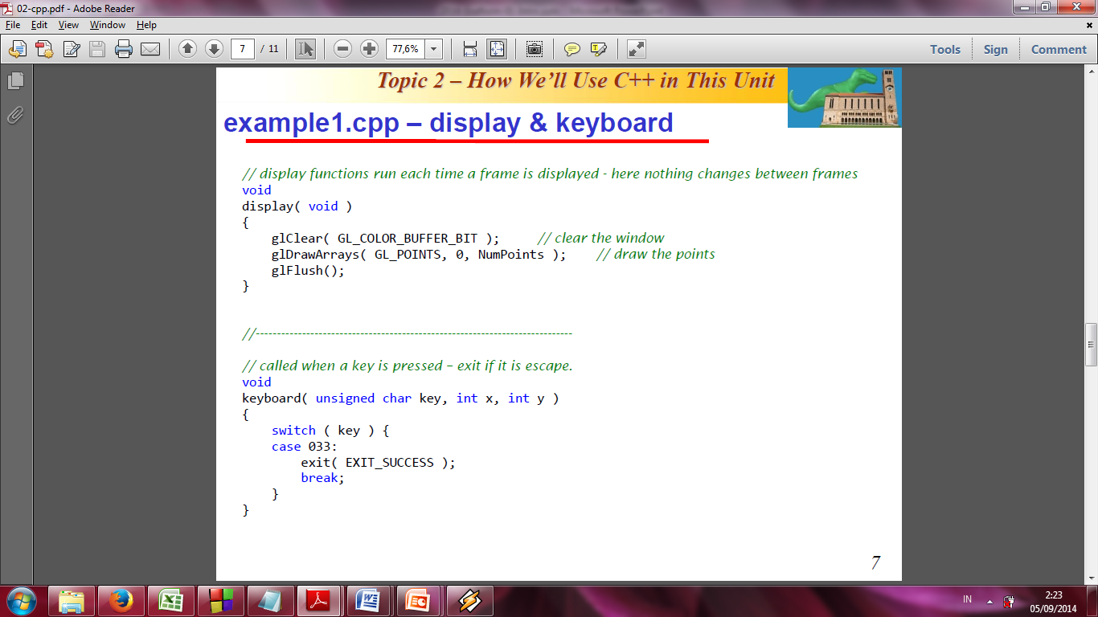
Menampilkan objek primitif di Modern OpenGL
Objek primitif di OpenGL dispesifikasikan dengan kumpulan verteks.
Setelah data verteks dihitung dan disimpan dalam array, program mengirim data tsb ke GPU.
Saat ingin ditampilkan objek geometri tertentu, fungsi dengan parameter objek primitif tsb dieksekusi.
Contoh apabila verteks Sierpinski gasket ingin digambar sebagai sebuah titik maka fungsi berikut dipanggil setelah data verteks telah dikirim ke GPUL:
glDrawArrays(GL_POINTS, 0, NumPoints);

Slide 22
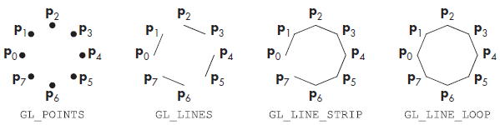
Line Segments
Lines: infinite
Line segments: finite between two vertices
Useful for approximating curves, displaying edges of closed objects

Slide 23

Polygons
Polygon (fill area): an object that has a border that can be described by a line loop but also has a well-defined interior
The performance of graphics systems is characterized by the number of polygons per second that can be rendered.
Methods of displaying a polygon: render only its edges, render its interior with a solid color or a pattern, and render or not render the edges

Slide 24
Polygon Issues
OpenGL will only display triangles
Simple: edges cannot cross
Convex: All points on line segment between two points in a polygon are also in the polygon
Flat: all vertices are in the same plane
Application program must tessellate a polygon into triangles (triangulation)
OpenGL 4.1 contains a tessellator
nonconvex polygon
nonsimple polygon

Slide 25
Polygon Testing
Conceptually simple to test for simplicity and convexity
Time consuming
Earlier versions assumed both and left testing to the application
Present version only renders triangles
Need algorithm to triangulate an arbitrary polygon

Slide 26
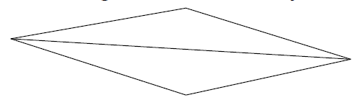
Good and Bad Triangles
Long thin triangles render badly
Equilateral triangles render well
Maximize minimum angle
Delaunay triangulation for unstructured points

Slide 27
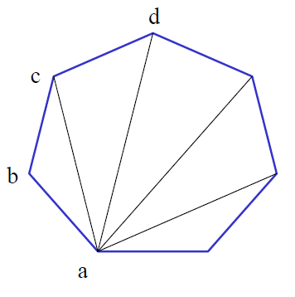
Triangularization
Convex polygon
Start with abc, remove b, then acd, ….

Slide 28
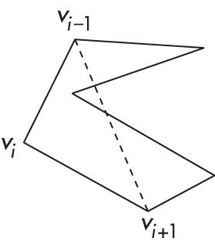
Non-convex (concave)

Slide 29
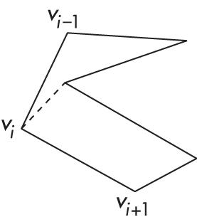
Recursive Division
Find leftmost vertex and split

Slide 30
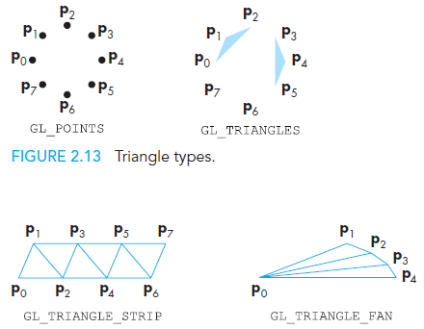
Polygons in OpenGL
The only OpenGL polygons that OpenGL supports are triangles.
Triangles can be displayed in three ways: as points corresponding to the vertices, as edges, or with the interiors filled.
glPolygonMode

Slide 31
Attributes
Attributes determine the appearance of objects
Color (points, lines, polygons)
Size and width (points, lines)
Stipple pattern (lines, polygons)
Polygon mode
Display as filled: solid color or stipple pattern
Display edges
Display vertices
Only a few (glPointSize) are supported by OpenGL functions

Slide 32
RGB color
Each color component is stored separately in the frame buffer
Usually 8 bits per component in buffer
Color values can range from 0.0 (none) to 1.0 (all) using floats or over the range from 0 to 255 using unsigned bytes

Slide 33
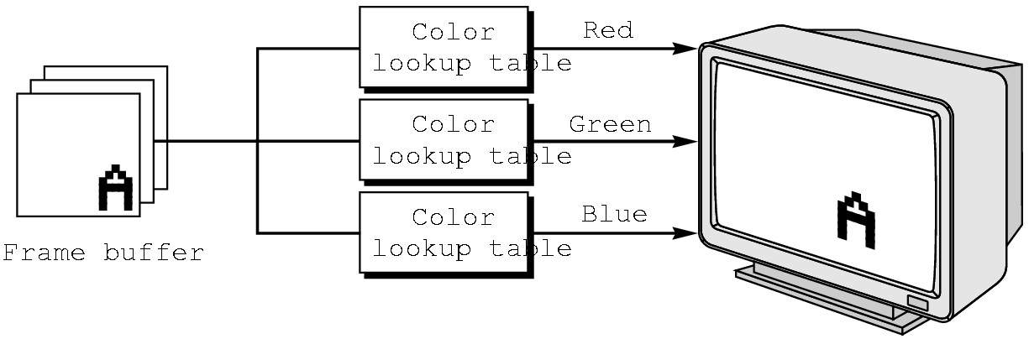
Indexed Color
Colors are indices into tables of RGB values
Requires less memory
indices usually 8 bits
not as important now

Slide 34
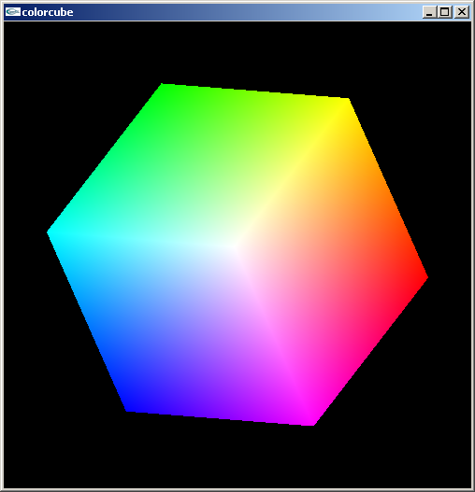
Smooth Color
Default is smooth shading
OpenGL interpolates vertex colors across visible polygons
Alternative is flat shading
Color of first vertex
determines fill color
Handle in shader

Slide 35
Setting Colors
Colors are ultimately set in the fragment shader but can be determined in either shader or in the application
Application color: pass to vertex shader as a uniform variable or as a vertex attribute
Vertex shader color: pass to fragment shader as varying variable
Fragment color: can alter via shader code

Slide 36
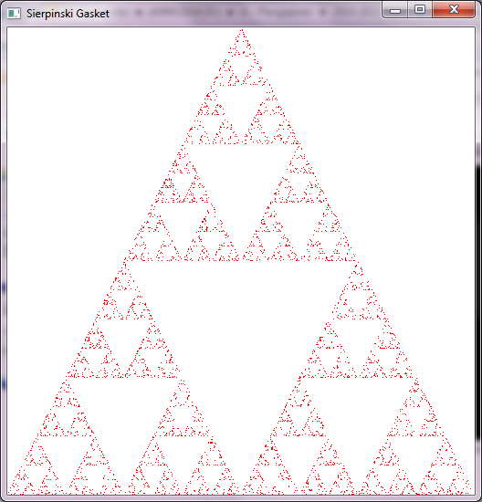
Example1.cpp
Output:

Slide 37
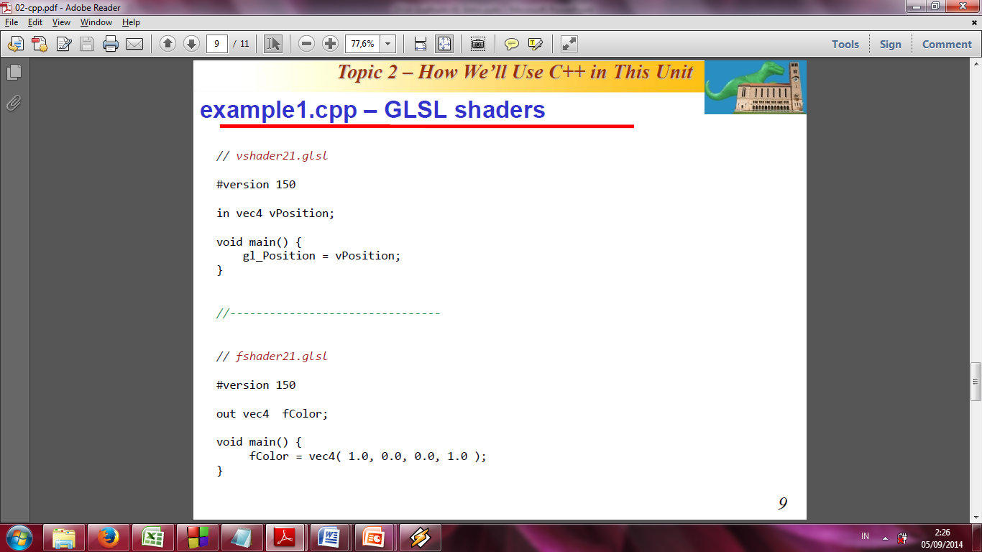
Example1.cpp – GLSL shaders
In example1.cpp, colors are ultimately set in the fragment shader:

Slide 38
Session 2: More GLSL

Slide 39
Objectives
Coupling shaders to applications
Reading
Compiling
Linking
Vertex Attributes
Setting up uniform variables
Example applications

Slide 40
Linking Shaders with Application
Read shaders
Compile shaders
Create a program object
Link everything together
Link variables in application with variables in shaders
Vertex attributes
Uniform variables

Slide 41
Program Object
Container for shaders
Can contain multiple shaders (fragment shader, vertex shader)
Other GLSL functions
GLuint myProgObj;
myProgObj = glCreateProgram();
// define shader objects here
// see InitShader.cpp
glLinkProgram(myProgObj);
glUseProgram(myProgObj);

Slide 42
Reading a Shader
Shaders are added to the program object and compiled
Usual method of passing a shader is as a null-terminated string using the function glShaderSource
If the shader is in a file, we can write a reader to convert the file to a string

Slide 43
Adding a Vertex Shader
GLuint program = glCreateProgram();
//Create vertex shader
GLuint vertexShader = glCreateShader(GL_VERTEX_SHADER);
//Get vertex source
const GLchar* vertexShaderSource[] =
{
"#version 140\n in vec4 vPosition; void main() { gl_Position = vPosition;}"
};
//Set vertex source
glShaderSource( vertexShader, 1, vertexShaderSource, NULL );
//Compile vertex source
glCompileShader( vertexShader );
//Attach vertex shader to program
glAttachShader( program, vertexShader );

Slide 44
Vertex Attributes
Vertex attributes are named in the shaders
Linker forms a table
Application can get index from table and tie it to an application variable
Similar process for uniform variables

Slide 45
Vertex Attribute Example
#define BUFFER_OFFSET( offset )
((GLvoid*) (offset))
GLuint loc = glGetAttribLocation( program, "vPosition" );
glEnableVertexAttribArray( loc );
glVertexAttribPointer( loc, 2, GL_FLOAT, GL_FALSE, 0, BUFFER_OFFSET(0) );

Slide 46
Uniform Variable Example
GLint angleParam;
angleParam = glGetUniformLocation(myProgObj,"angle");
/* angle defined in shader */
/* my_angle set in application */
GLfloat my_angle;
my_angle = 5.0 /* or some other value */
glUniform1f(angleParam, my_angle);

Slide 47
Double Buffering
Updating the value of a uniform variable opens the door to animating an application
Execute glUniform in display callback
Force a redraw through glutPostRedisplay()
Need to prevent a partially redrawn frame buffer from being displayed
Draw into back buffer
Display front buffer
Swap buffers after updating finished

Slide 48
Adding Double Buffering
Request a double buffer
glutInitDisplayMode(GLUT_DOUBLE)
Swap buffers
void mydisplay()
{
glClear(……);
glDrawArrays();
glutSwapBuffers();
}

Slide 49
Idle Callback
Idle callback specifies function to be executed when no other actions pending
glutIdleFunc(myIdle);
void myIdle()
{
// recompute display
glutPostRedisplay();
}

Slide 50
Attribute and Varying Qualifiers
Starting with GLSL 1.5 attribute and varying qualifiers have been replaced by in and out qualifiers
No changes needed in application
Vertex shader example:
#version 1.4
attribute vec3 vPosition;
varying vec3 color;
#version 1.5
in vec3 vPosition;
out vec3 color;

Slide 51
Adding Color
If we set a color in the application, we can send it to the shaders as a vertex attribute or as a uniform variable depending on how often it changes
Let’s associate a color with each vertex
Set up an array of same size as positions
Send to GPU as a vertex buffer object

Slide 52
Setting Colors
typedef vec3 color3;
color3 base_colors[4] = {color3(1.0, 0.0, 0.0), ….
color3 colors[NumVertices];
vec3 points[NumVertices];
//in loop setting positions
colors[i] = basecolors[color_index]
position[i] = …….

Slide 53
Setting Up Buffer Object
//need larger buffer
glBufferData(GL_ARRAY_BUFFER, sizeof(points) + sizeof(colors), NULL, GL_STATIC_DRAW);
//load data separately
glBufferSubData(GL_ARRAY_BUFFER, 0, sizeof(points), points);
glBufferSubData(GL_ARRAY_BUFFER, sizeof(points), sizeof(colors), colors);

Slide 54
Second Vertex Array
// vPosition and vColor identifiers in vertex shader
loc = glGetAttribLocation(program, “vPosition”);
glEnableVertexAttribArray(loc);
glVertexAttribPointer(loc, 3, GL_FLOAT, GL_FALSE, 0, BUFFER_OFFSET(0));
loc2 = glGetAttribLocation(program, “vColor”);
glEnableVertexAttribArray(loc2);
glVertexAttribPointer(loc2, 3, GL_FLOAT, GL_FALSE, 0,
BUFFER_OFFSET(sizeofpoints));

Slide 55
Vertex Shader Applications
Moving vertices
Morphing
Wave motion
Fractals
Lighting
More realistic models
Cartoon shaders

Slide 56
Wave Motion Vertex Shader
in vec4 vPosition;
uniform float xs, zs, // frequencies
uniform float h; // height scale
void main()
{
vec4 t = vPosition;
t.y = vPosition.y
+ h*sin(time + xs*vPosition.x)
+ h*sin(time + zs*vPosition.z);
gl_Position = t;
}

Slide 57
Particle System
in vec3 vPosition;
uniform mat4 ModelViewProjectionMatrix;
uniform vec3 init_vel;
uniform float g, m, t;
void main()
{
vec3 object_pos;
object_pos.x = vPosition.x + vel.x*t;
object_pos.y = vPosition.y + vel.y*t
+ g/(2.0*m)*t*t;
object_pos.z = vPosition.z + vel.z*t;
gl_Position =
ModelViewProjectionMatrix*vec4(object_pos,1);
}

Slide 58
Pass Through Fragment Shader
/* pass-through fragment shader */
in vec4 color;
void main(void)
{
gl_FragColor = color;
}

Slide 59
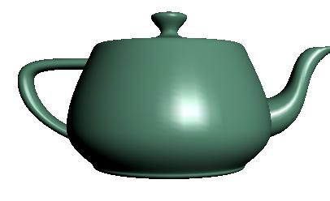
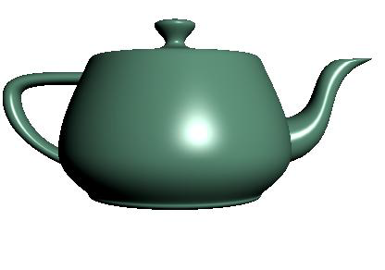
Vertex vs Fragment Lighting
per vertex lighting
per fragment lighting

Slide 60
Fragment Shader Applications
Texture mapping
smooth shading environment mapping bump mapping

Slide 61
Next Week: Programming in OpenGL: Three Dimensions
Also Input and Interaction
Read the Textbook Ch. 2 (pp 91 – 107)

Slide 62
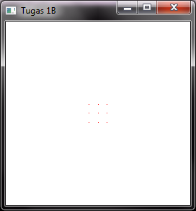
Task #2
Based on Example 1 in Chapter 2, create a program that shows two dimensional points specified directly using a points array.
For example, using a 256x256 window, and 9 points as the following coordinates:
(-0.1, -0.1 ), (-0.1, 0.0), (-0.1, 0.1), ( 0.0, -0.1), ( 0.0, 0.0), ( 0.0, 0.1), ( 0.1, -0.1), ( 0.1, 0.0), ( 0.1, 0.1)
the program will show this figure →
Create an image as artistic as possible ☺

Slide 63
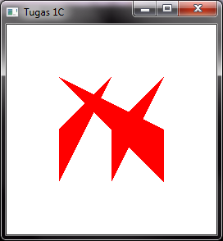
Task #3
Based on Example 2 in Chapter 2, create a program that shows two dimensional triangles specified directly using a points array.
For example, using a 256x256 window, and 3 triangles of the following coordinates:
(-0.5, -0.5 ), (-0.5, 0.0), ( 0.0, 0.5)
( 0.0, -0.5), ( 0.0, 0.0), ( 0.5, 0.5)
( 0.5, -0.5), ( 0.5, 0.0), (-0.5, 0.5)
the program will show this figure →
Create an image as artistic as possible ☺

